Slide 1

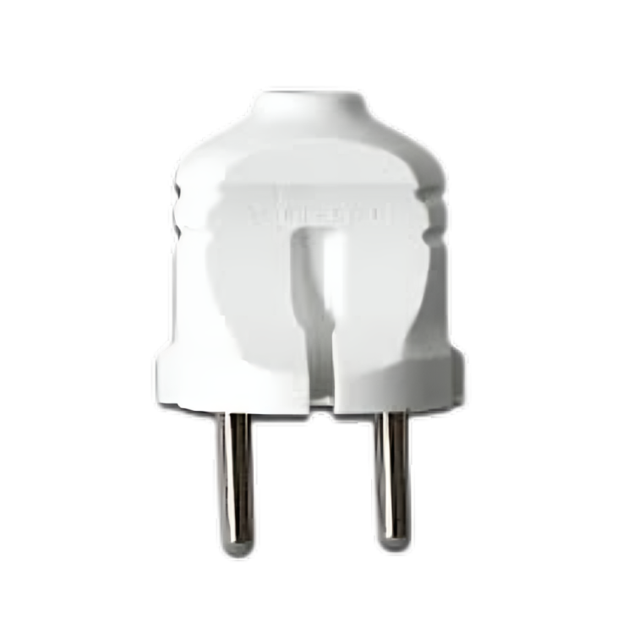
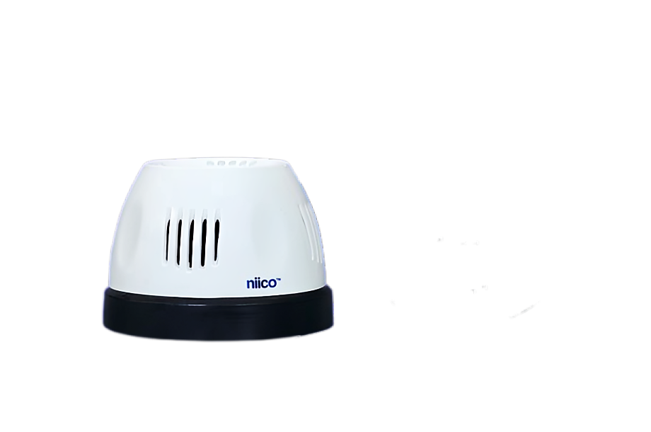
Light
2 Pin Plug

Slide 2
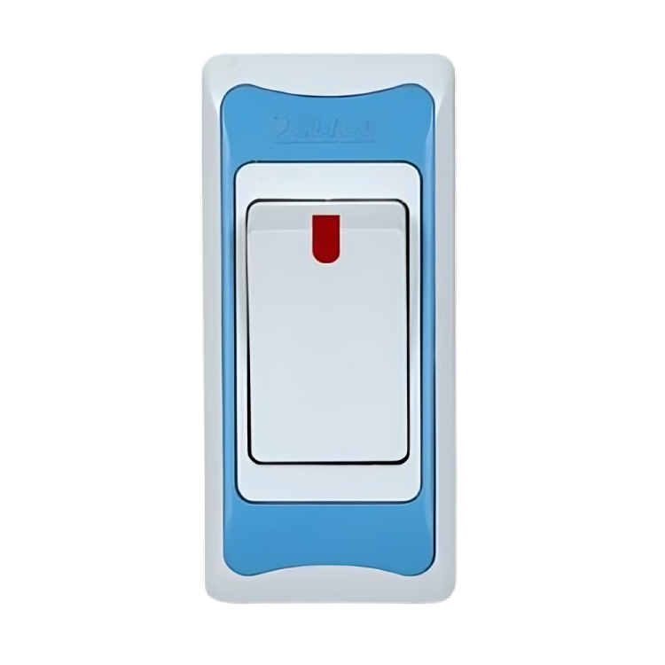
2 Pin Plug
Switch
Light

Slide 3
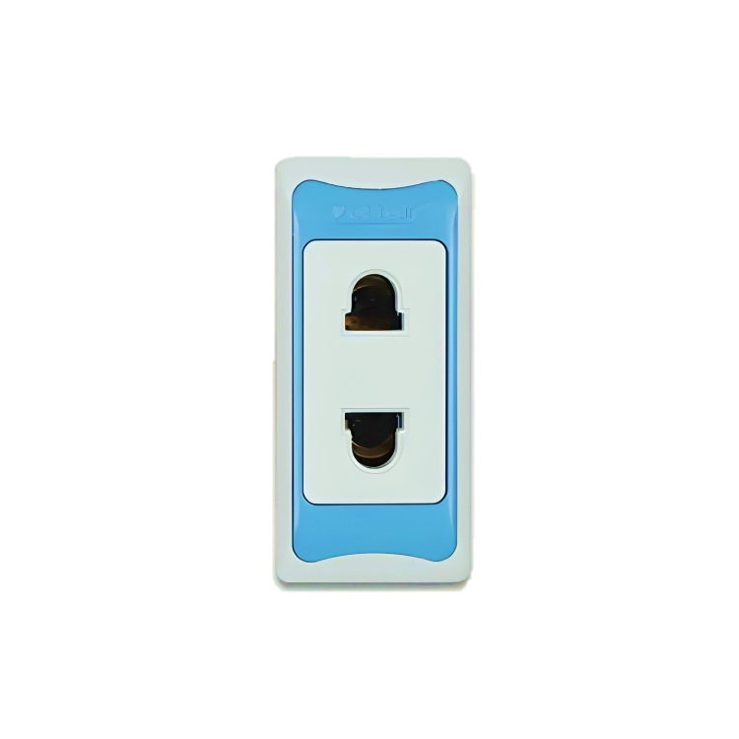
2 pin socket connection
2 Pin Socket
2 Pin Plug

Slide 4
2 pin socket connection
Switch
2 Pin Socket
2 Pin Plug

Slide 5
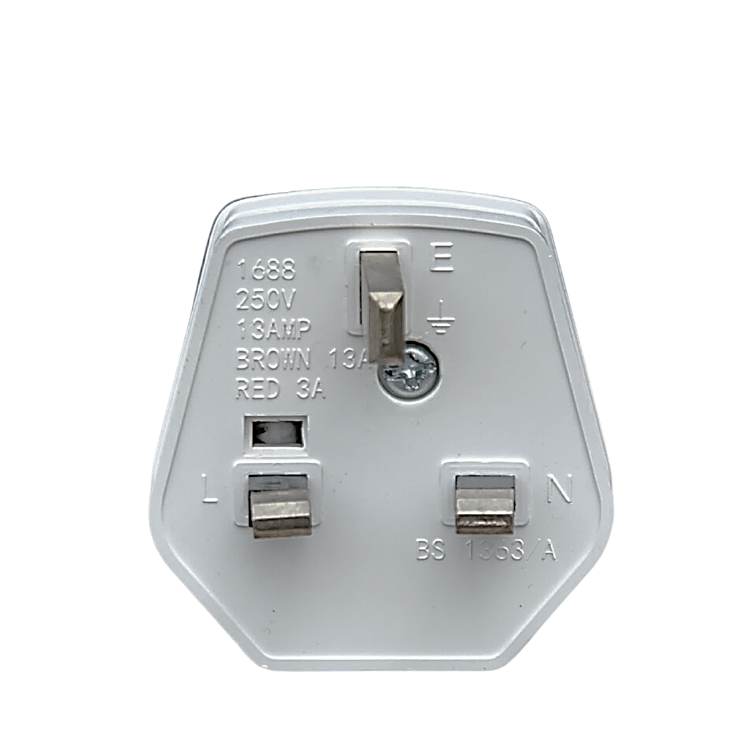
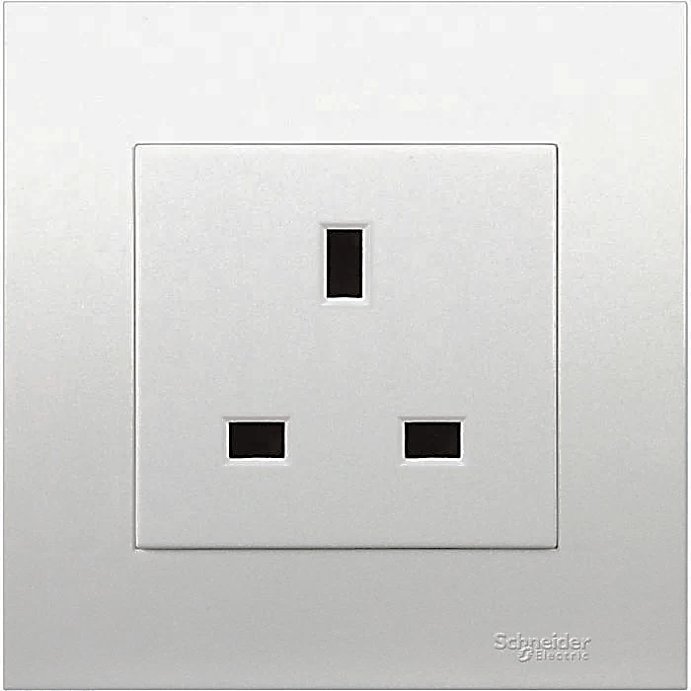
3 pin socket connection
3 Pin Plug
3 Pin Socket

Slide 6
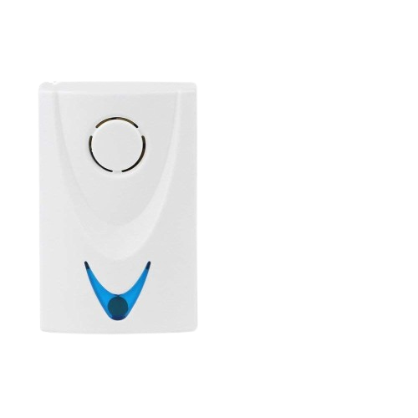
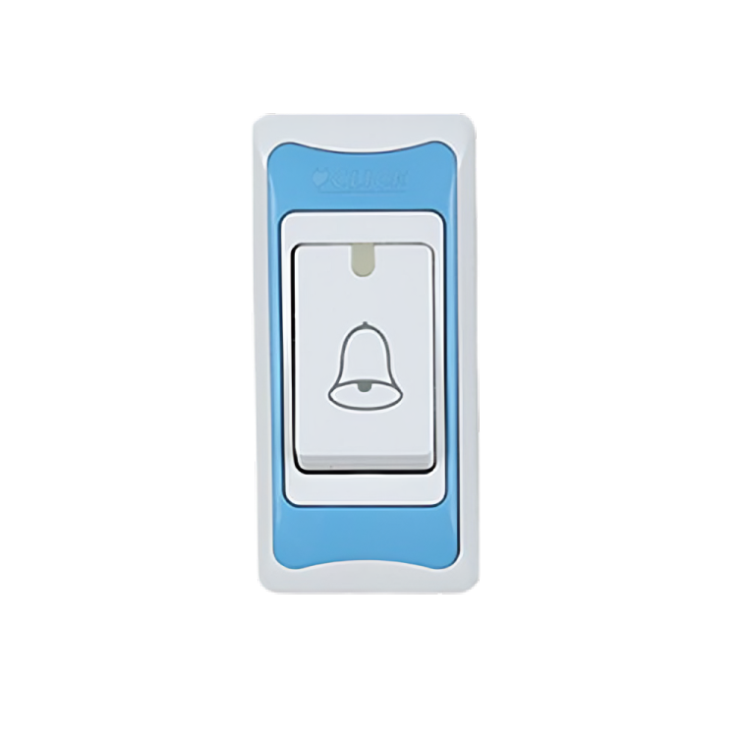
Source
L
Bell Switch
Calling Bell
N

Slide 7
Source
L
N
Calling Bell
Bell Switch
Bell Switch

Slide 8

Bell
Source
L
N
Bell
Bell Switch

Slide 9
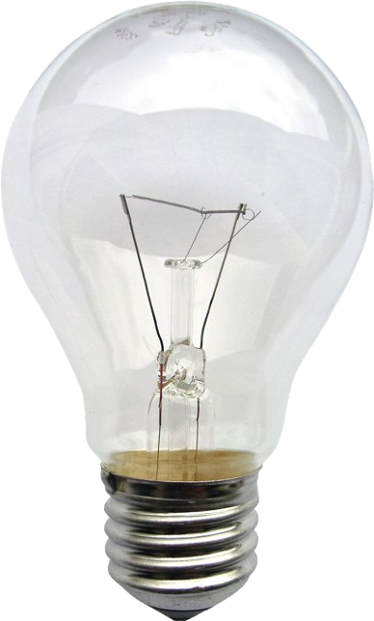
Series Bell circuit
Source
L
Bell Switch
Light
Calling Bell
N

Slide 10
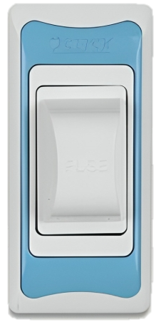
Simple circuit
Source
L
N
Fuse
Switch
Light

Slide 11
Series circuit
Source
L
N
Fuse
Switch
Light 1
Light 2

Slide 12
Parallel circuit
Source
L
N
Fuse
Switch 1
Switch 2
Light 2
Light 1

Slide 13
Mix circuit
Source
L
N
Fuse
Switch
Light
Light
Light
Light

Slide 14
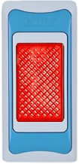
Multiplug circuit
Piano
Source
L
N
Fuse
Indecator
Switch
Socket
Switch
Socket

Slide 15
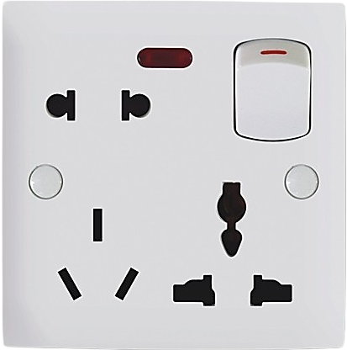
Multiplug circuit
Gang
Source
L
N
3 Pin Socket
E

Slide 16
Series Bord Connection circuit
Source
L
N
Fuse
Indecator
Switch
Light
Socket

Slide 17
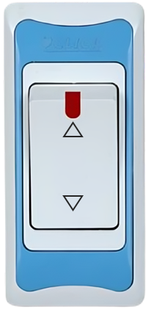
light control 2 different place with two way switch circuit
Source
L
Light
Two way Switch
Two way Switch
N

Slide 18
Tunnel wiring circuit
Light
Light
Light
Light
Source
L
N
Fuse
Indecator
Switch
2 way
Switch
2 way
Switch
2 way
Switch

Slide 19

Calling Indicator
Source
L
N
Bell
Switch 1
Switch 2

Slide 20
Emergency alarm circuit
Bell 1
Source
L
N
Switch 1
Bell 2
Switch 2

Slide 21


Regulator connection circuit
Source
L
Switch
Regulator
FAN
N

Slide 22
Switch bord connection circuit
Source
L
N
Fuse
Indecator
Switch
Light
Switch
Light
Switch
Regulator
Fan

Slide 23
Switch bord connection circuit
Light
Light
Fan
Source
L
N
Fuse
Indecator
Switch
Switch
Switch
Switch
Socket
Regulator

Slide 24
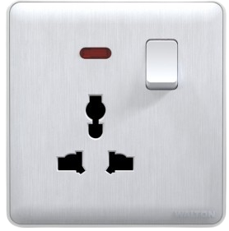

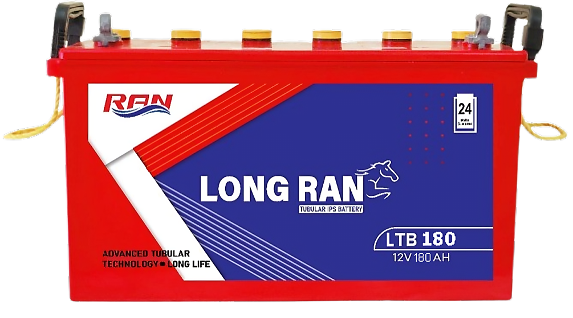
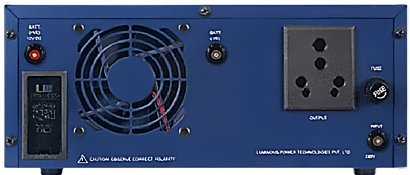

Source
Fuse
Indecator
Switch
Light
Switch
Light
Switch
Regulator
Fan
L
N
12 Volt
100 Ah

Slide 25


Water Pump Control with Float Switch
Single Condition
CB
Float Switch
MC= Magnetic Conductor
L
A1
MC
A2
N
Float Switch circuit diagram

Slide 26
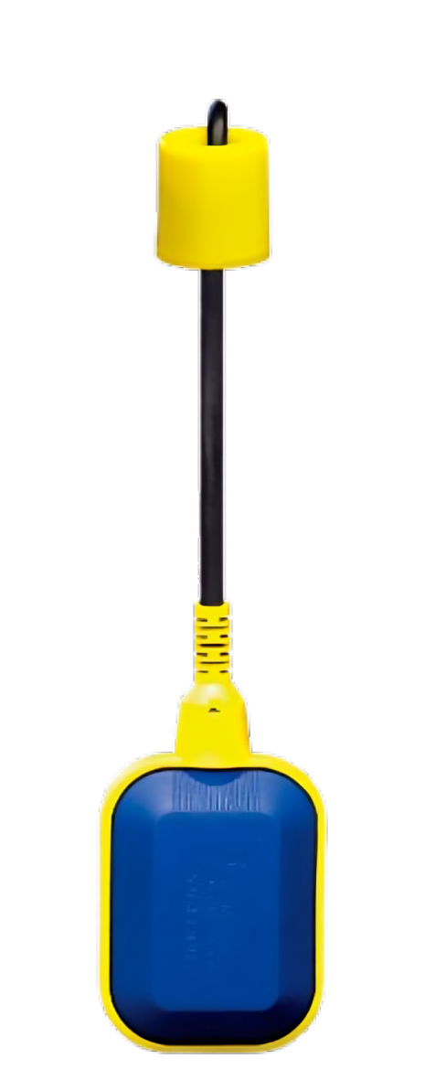
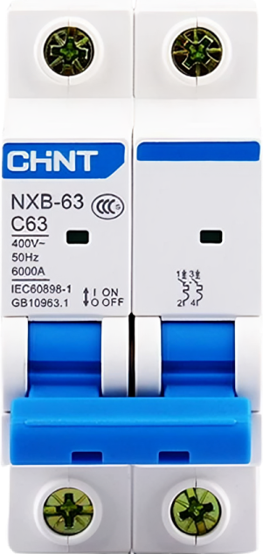
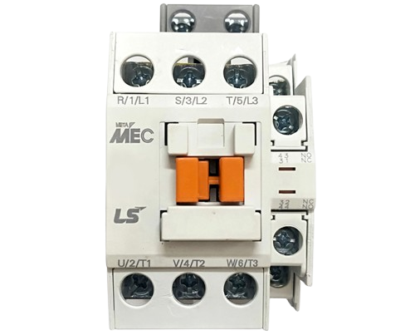
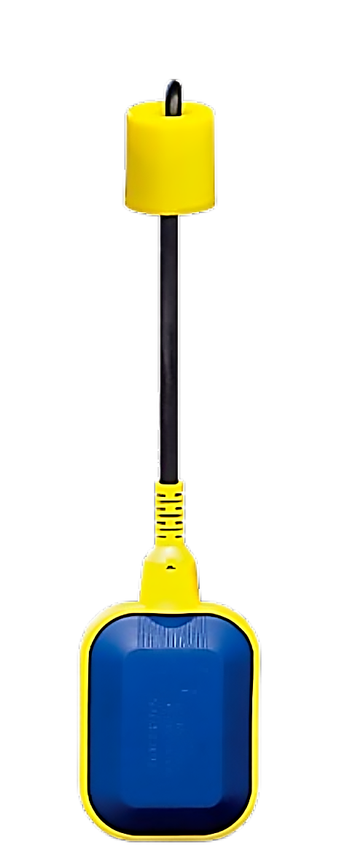
Water Pump Control with Float Switch
Single Condition
L
N
NC
com
NO
Float Switch Connection diagram

Slide 27
Water Pump Control with Float Switch
Double Condition
CB
Float Switch
Float Switch
L
A1
MC
A2
N
Float Switch circuit diagram

Slide 28
Water Pump Control with Float Switch
Double Condition
L
N
NC
NO
Com
NO
Com
NC
Float Switch Connection diagram

Slide 29
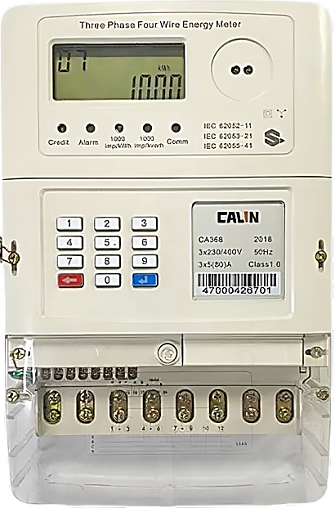
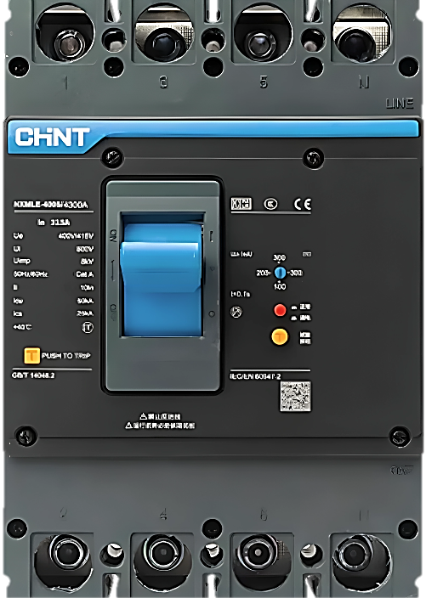
3 phase meter
Line 1 Busbar
Line 2 Busbar
MCCB
Line 3 Busbar
Neutral Busbar
Earthing Busbar

Slide 30
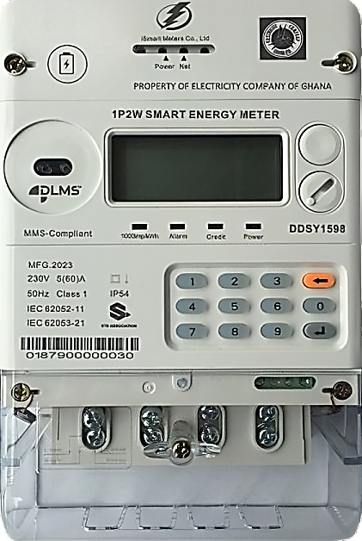
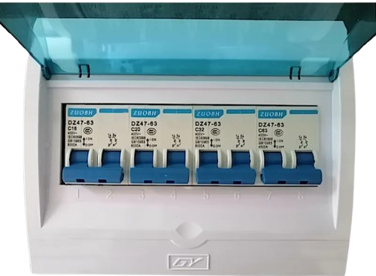

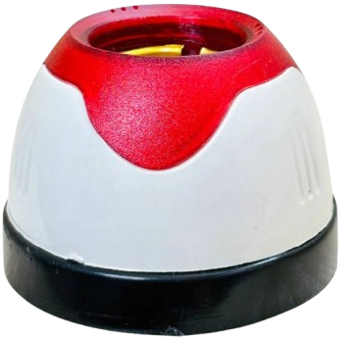
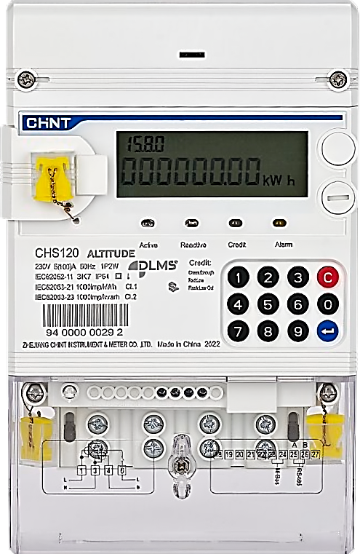
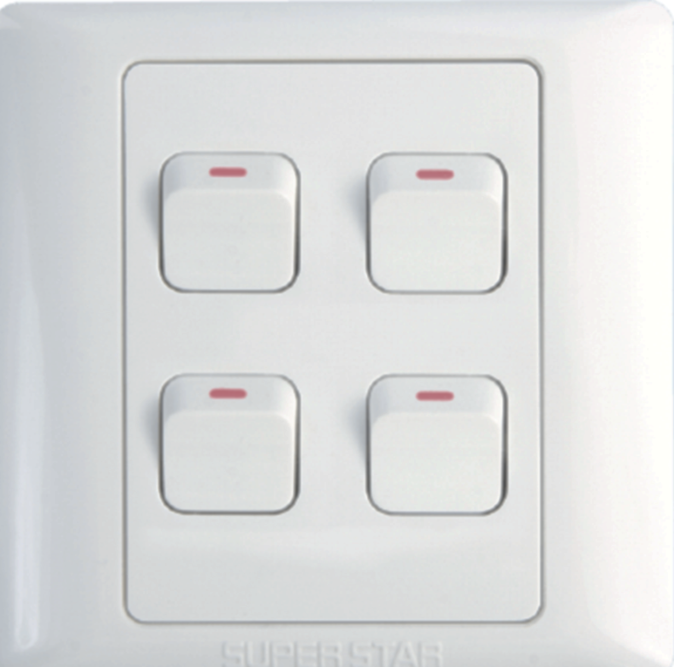
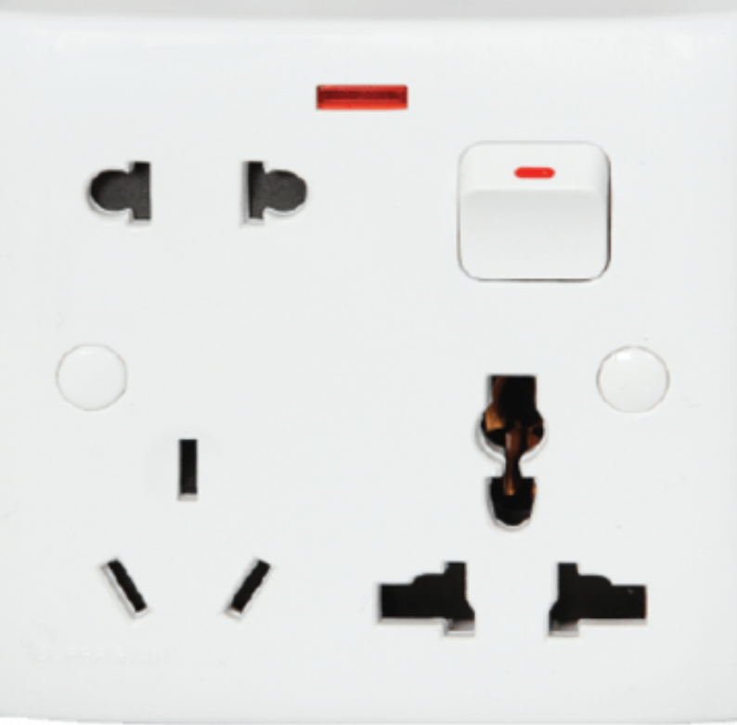
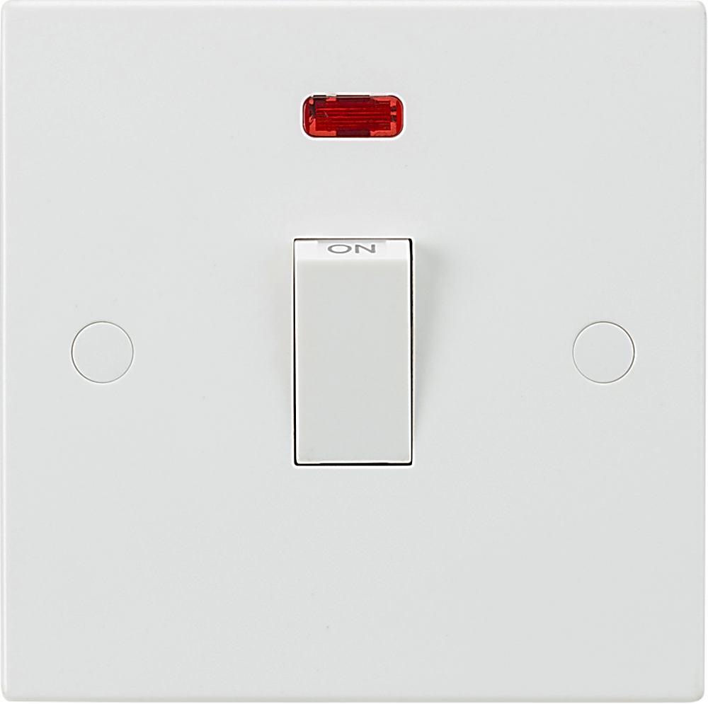
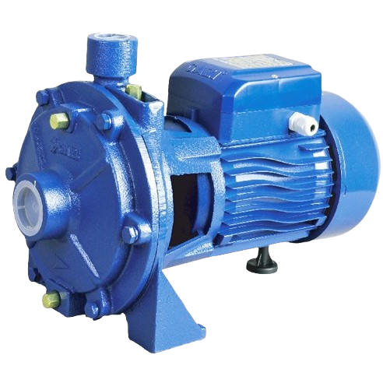
Sub Meter
SDB Box
Light
MCB
Main Meter
Motor
MCB
MCB
Switch Board
DP Switch

Slide 31
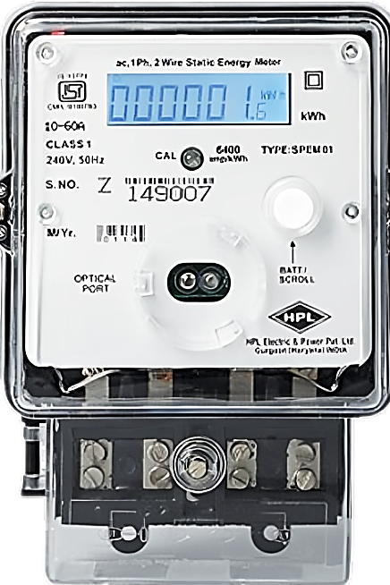
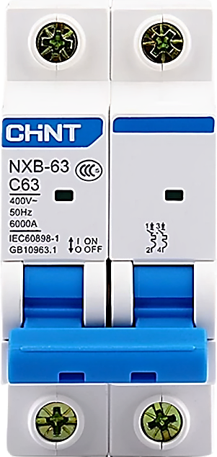
Main Meter
Busbar
Sub Meter 1
MCB
MCB
Sub Meter 2
MCB
MCB
Sub Meter 3
Switch Board
MCB
Earthing Busbar
Motor

Slide 32
3 Phase Meter
Busbar
1 Phase Meter
MCB
MCB
MCCB
MCB
MCB
Earthing Busbar
3Φ(Phase) Output
1Φ(Phase) Output

Slide 33
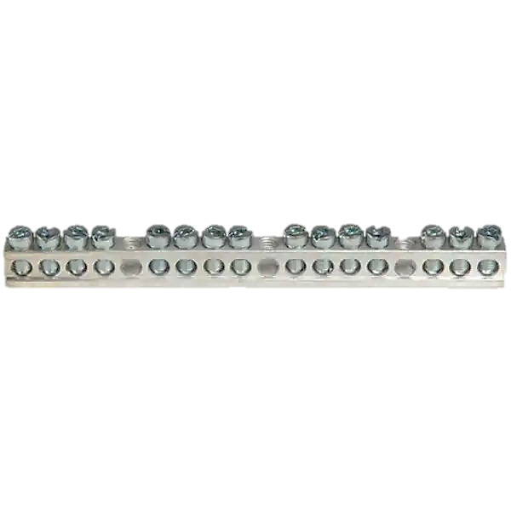
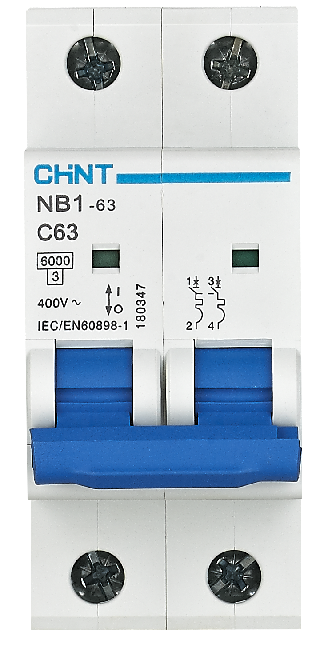
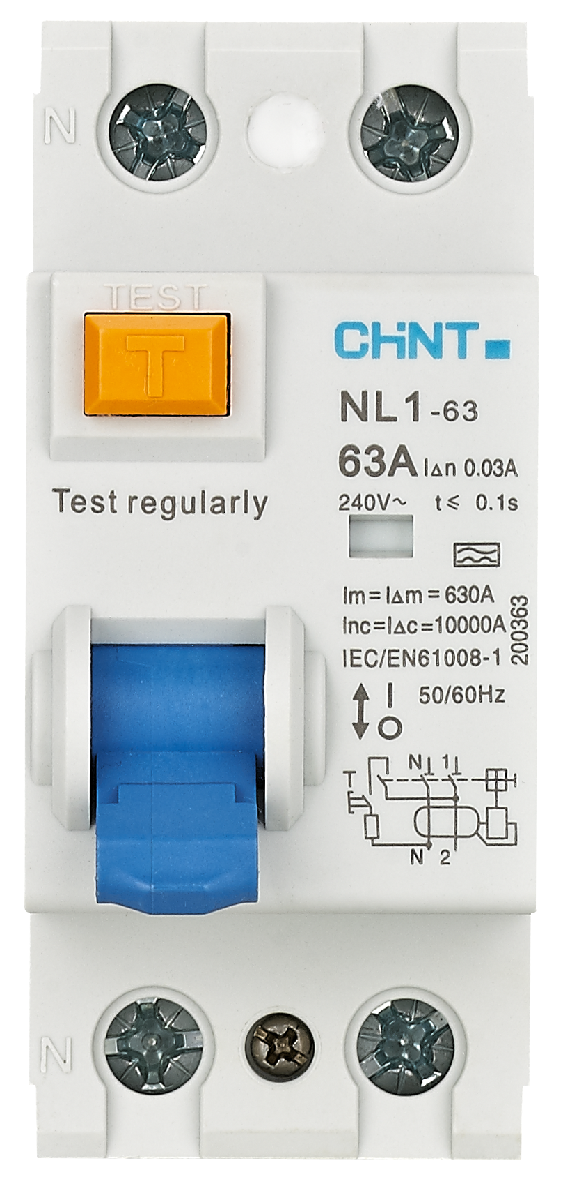
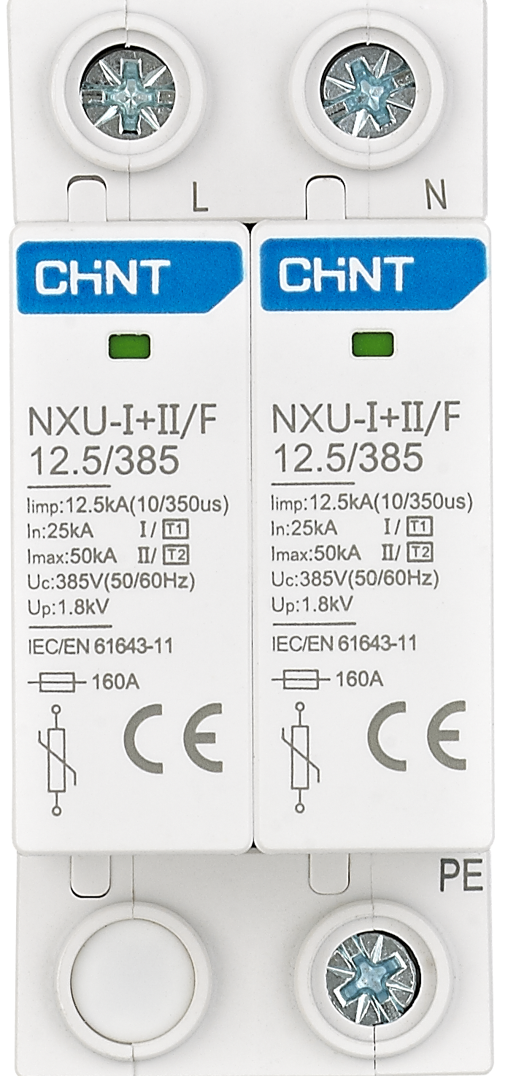
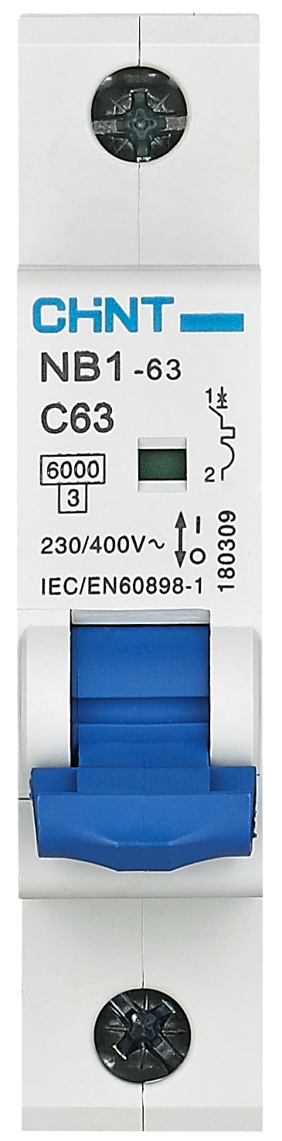
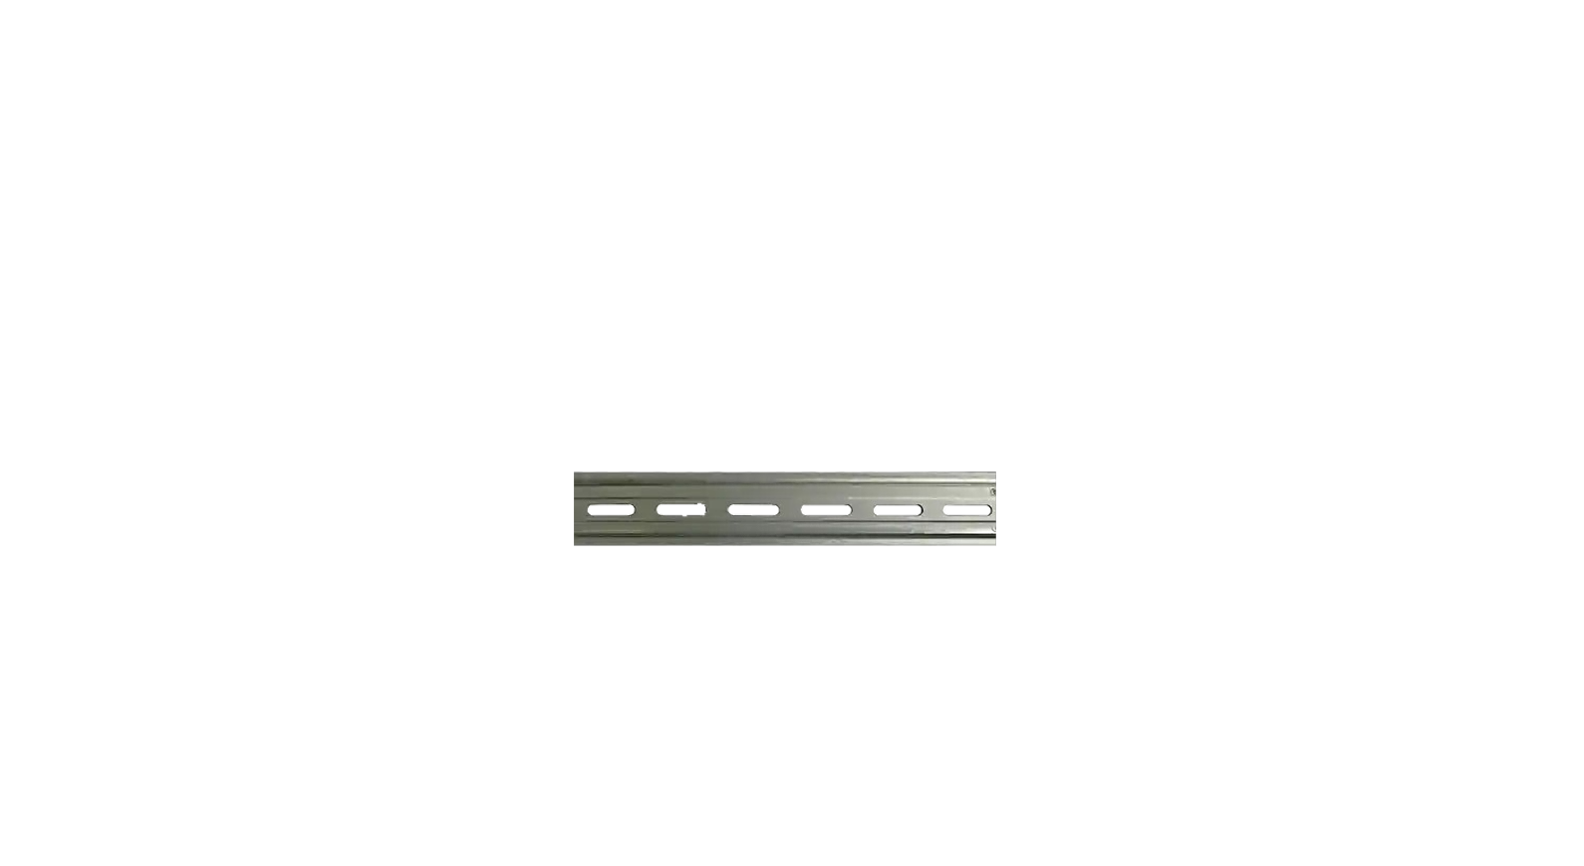
Neutral Busbar
AC/GEYSER
R1
R2
R3
R4
K
Flat-1 SDB
(Sub Distribution Box)
MCB
RCCB
SPD
MCB
SP
SP
SP
SP
SP
Earthing
Busbar
ENERGY
METER
Flat-1
Main
MCB
L
Earthing
Earthing
N

Slide 34
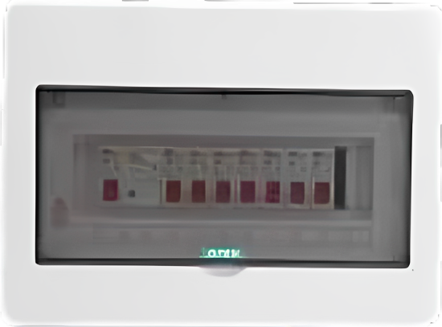
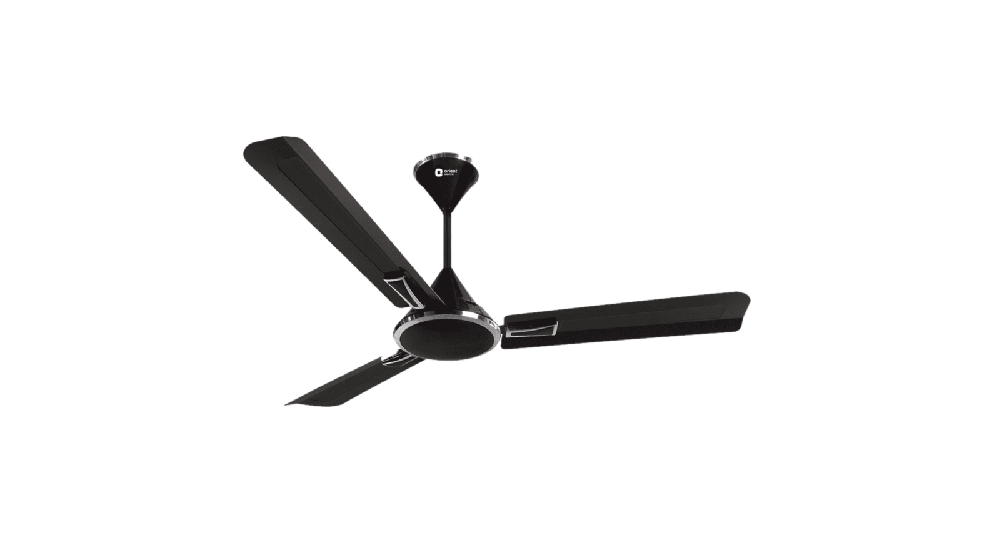

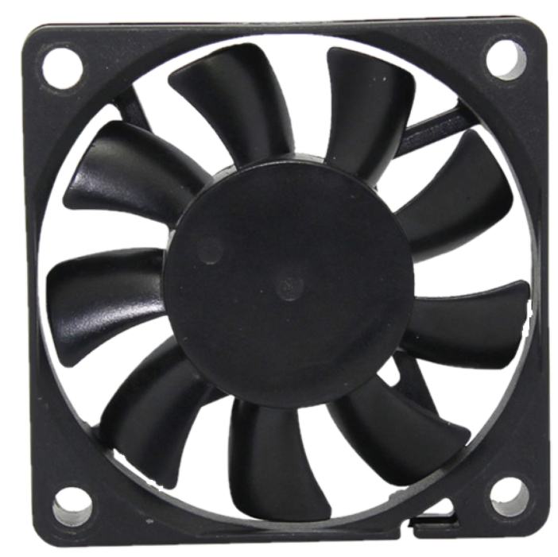
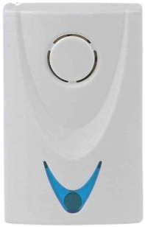
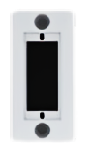
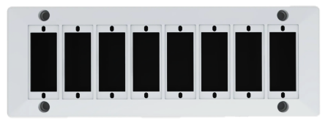
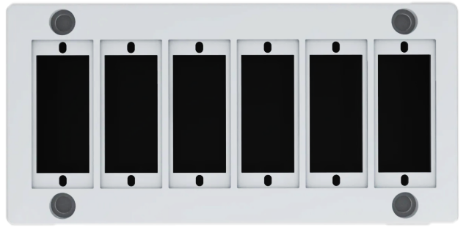
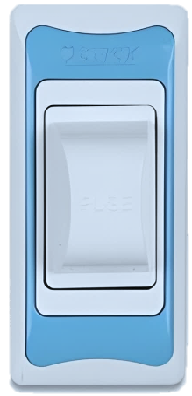
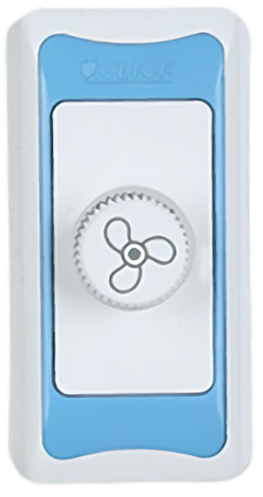
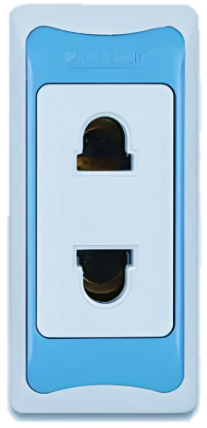
Exhaust Fan
Ceiling
Rose
Ceiling Fan
SDB
Box
Light
Doorbell
Light-1
Light-2
ENERGY
METER
MCB
Piano Switch
board
Bell Switch
L
N

Slide 35
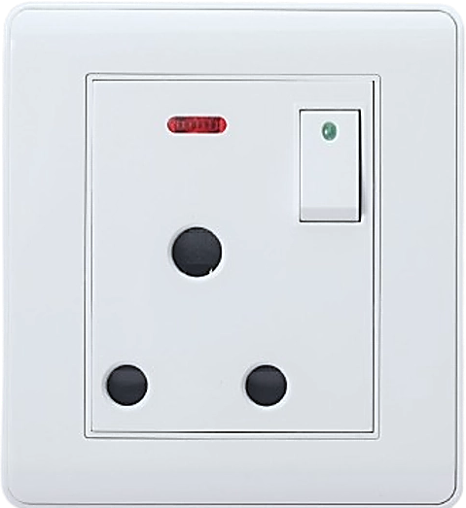
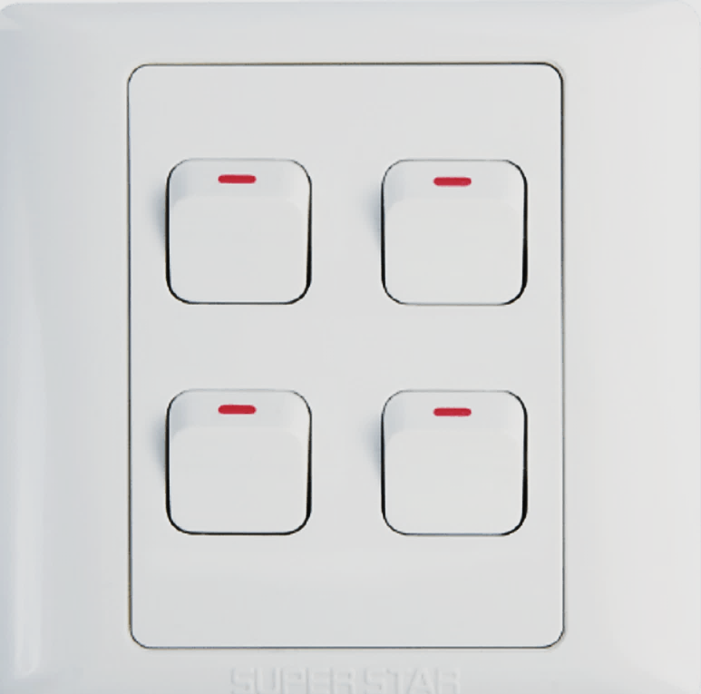



Ceiling
Rose
Ceiling Fan
Exhaust Fan
SDB
Box
AC Socket
Doorbell
Light
Light-1
Light-2
ENERGY
METER
MCB
Gang Switch
board
Bell Switch
L
N

Slide 36
Ceiling
Rose
Ceiling
Rose
Ceiling Fan
Ceiling Fan
SDB
Box
AC Socket
Doorbell
Light-1
Light-2
Light-1
Light-2
ENERGY
METER
Piano Switch
board
Gang Switch
board
MCB
Bell Switch
L
N

Slide 37
Bell 2
Source
L
N
Bell 2
Bell Switch

Slide 38
Switch bord connection circuit
Source
L
N
Fuse
Indecator
Switch
Light
Switch
Light
Switch
Regulator
Fan

Slide 39
Multiplug circuit
L
Source
N
Fuse
Indecator
Switch
Socket
Switch
Socket
Switch
Socket

Slide 40
2 pin socket circuit
2 pin socket circuit
L
Source
Fuse
Switch
Socket
N

Slide 41
2 Switch Door Bell Connection circuit
Source
L
N
Bell

Slide 42
Calling Indicator circuit
Source
L
N
Fuse
Indecator
Switch
Light
Switch
Light
Switch
Light
Bell

